Slide 1
Trustworthy Machine Learning Copyright and Generative AI/ML
Sangdon Park
POSTECH

Slide 2
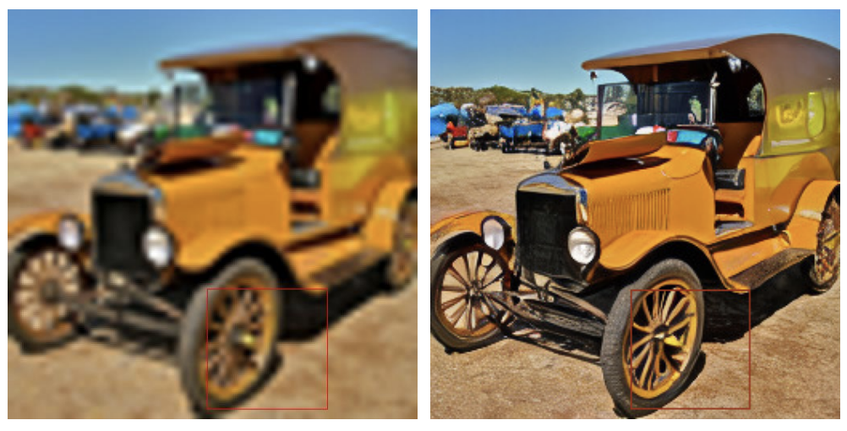
Powerful Generative AI/ML
Super-resolution
Image Credit: https://arxiv.org/pdf/2112.10752.pdf

Slide 3
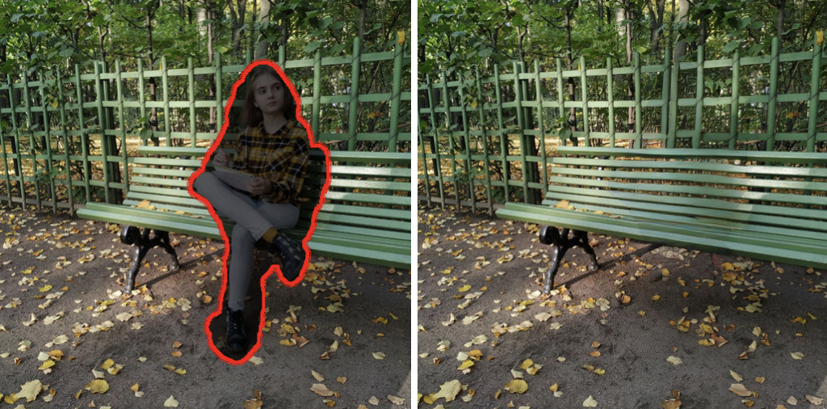
Powerful Generative AI/ML
Removal and Inpainting
Image Credit: https://arxiv.org/pdf/2112.10752.pdf

Slide 4
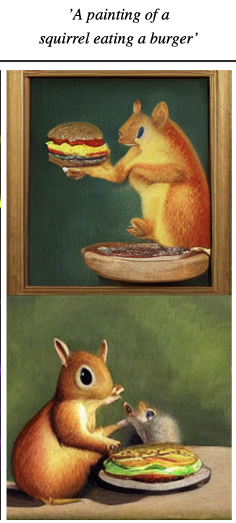
Powerful Generative AI/ML
Text-to-Image Synthesis
Image Credit: https://arxiv.org/pdf/2112.10752.pdf

Slide 5
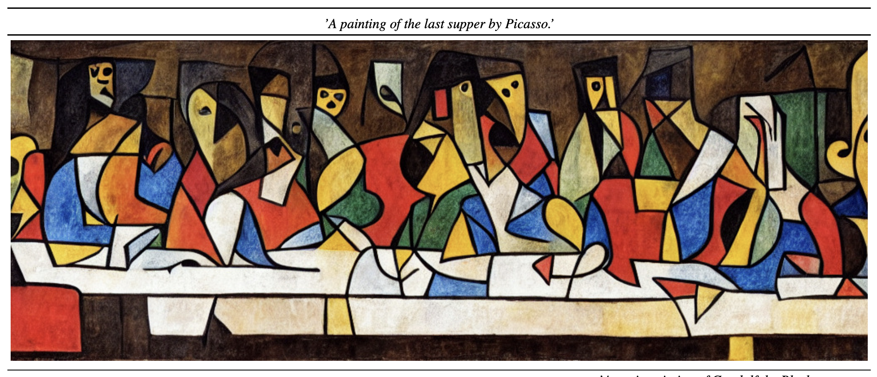
Stable Diffusion (=Latent Diffusion Models)
Image Credit: https://arxiv.org/pdf/2112.10752.pdf

Slide 6
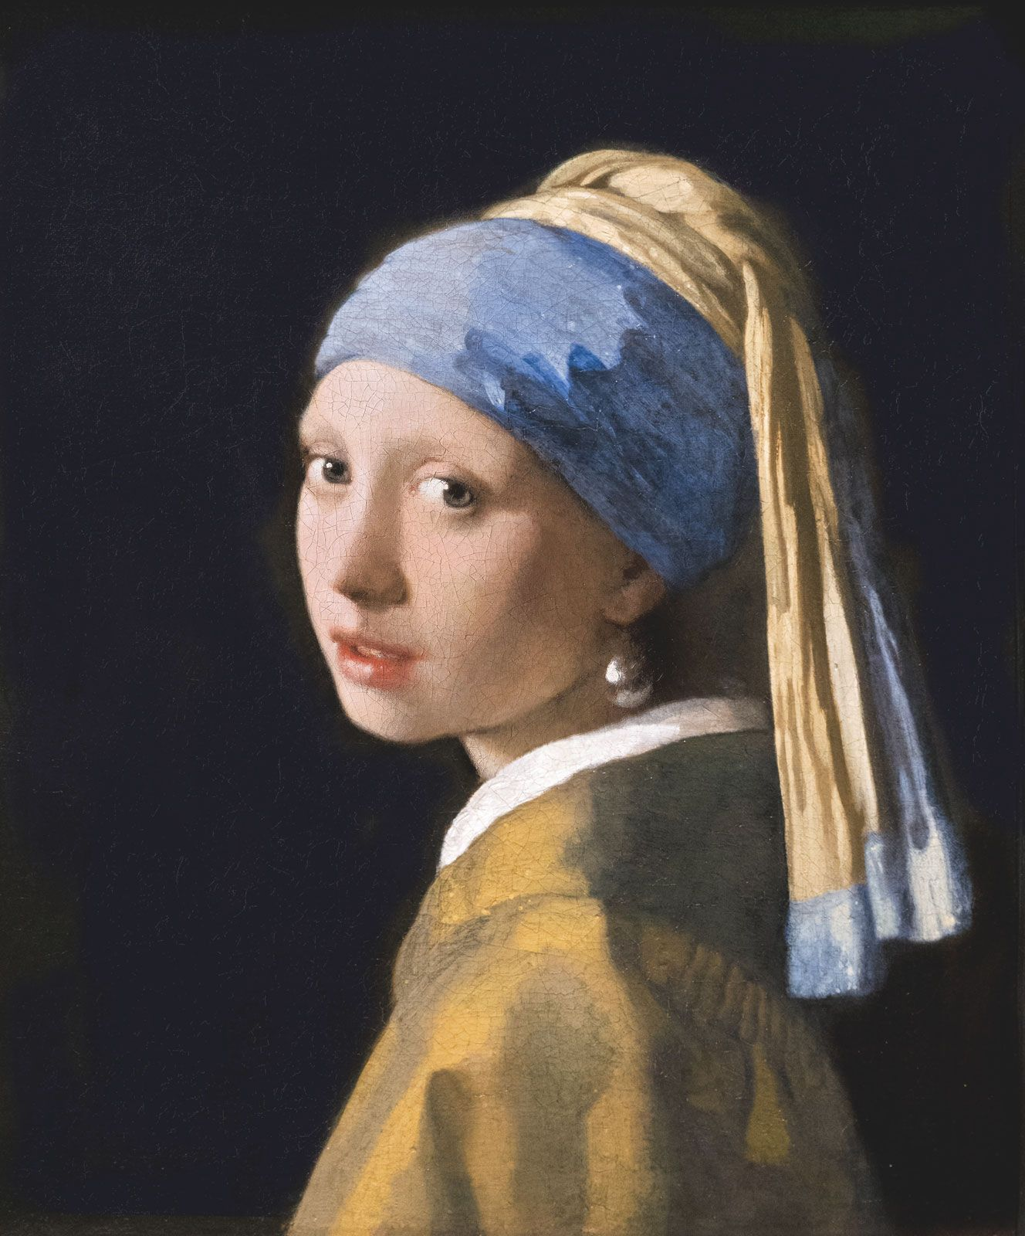
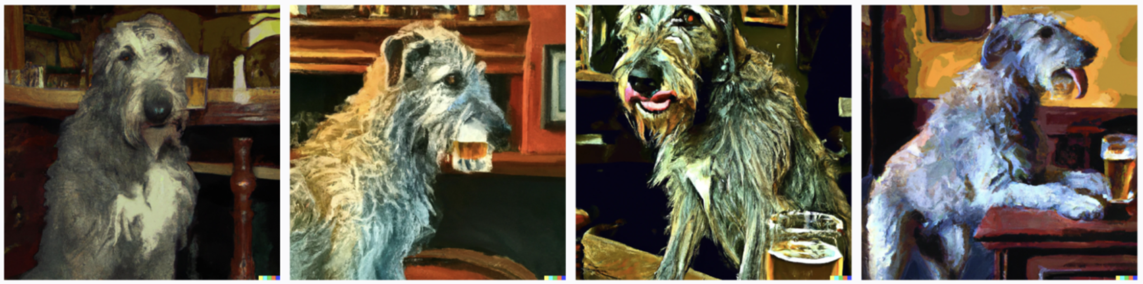
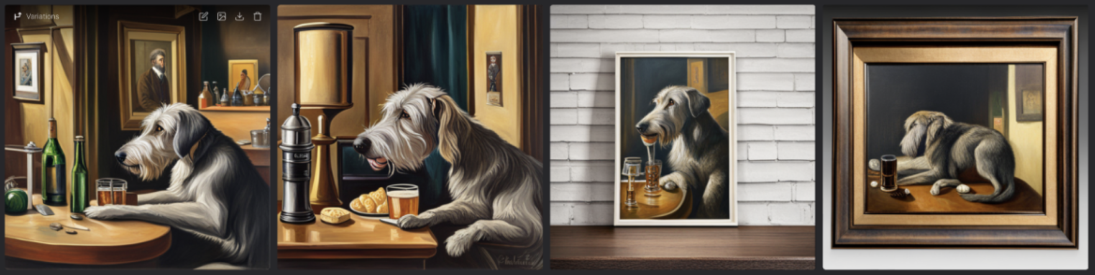
Stable Diffusion v.s. DALL-E
Girl with a Pearl Earring by Vermeer
Prompt: “A painting by Vermeer of an Irish wolfhound enjoying a pint of a traditional pub”
DALL-E
Stable Diffusion
Image Credit: https://zapier.com/blog/stable-diffusion-vs-dalle/

Slide 7
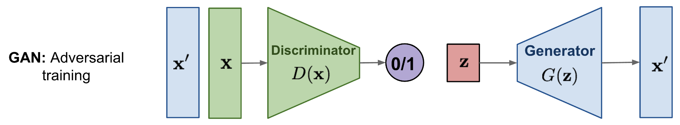
Density Estimation: GAN
Image Credit: https://lilianweng.github.io/posts/2021-07-11-diffusion-models/

Slide 8
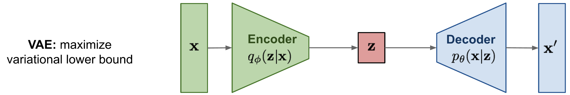
Density Estimation: VAE
Image Credit: https://lilianweng.github.io/posts/2021-07-11-diffusion-models/

Slide 9
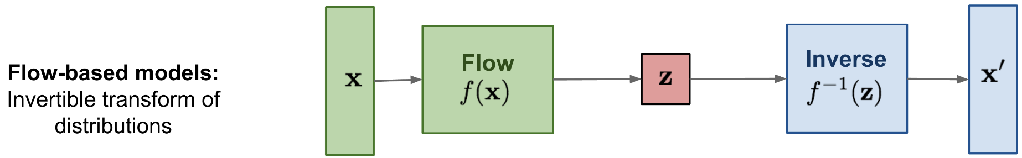
Density Estimation: Flow-based Models
Image Credit: https://lilianweng.github.io/posts/2021-07-11-diffusion-models/

Slide 10
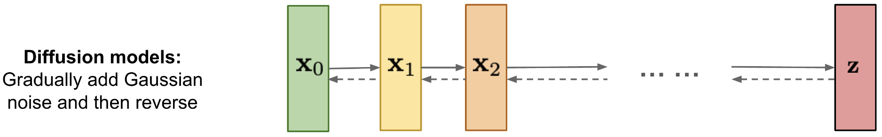
Density Estimation: Diffusion Models
Image Credit: https://lilianweng.github.io/posts/2021-07-11-diffusion-models/

Slide 11
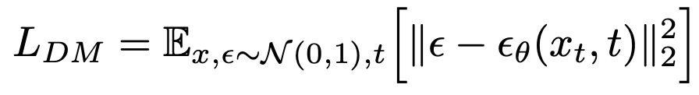
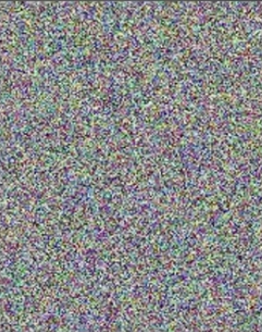
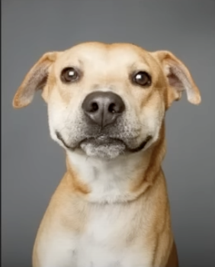
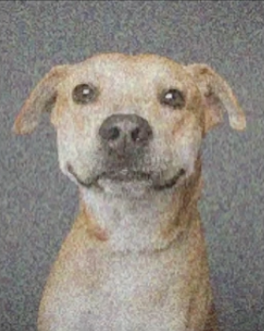
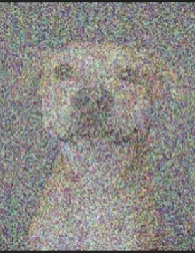
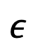
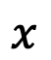
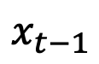
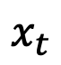
Diffusion Models: Diffusion Process
Predict noise via self-supervised learning!
$$ε$$
$$x$$
$$x_{t−1}$$
$$x_{t}$$
Diffusion
…
Image Credit: https://www.youtube.com/watch?v=J87hffSMB60&ab_channel=AICoffeeBreakwithLetitia

Slide 12
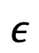
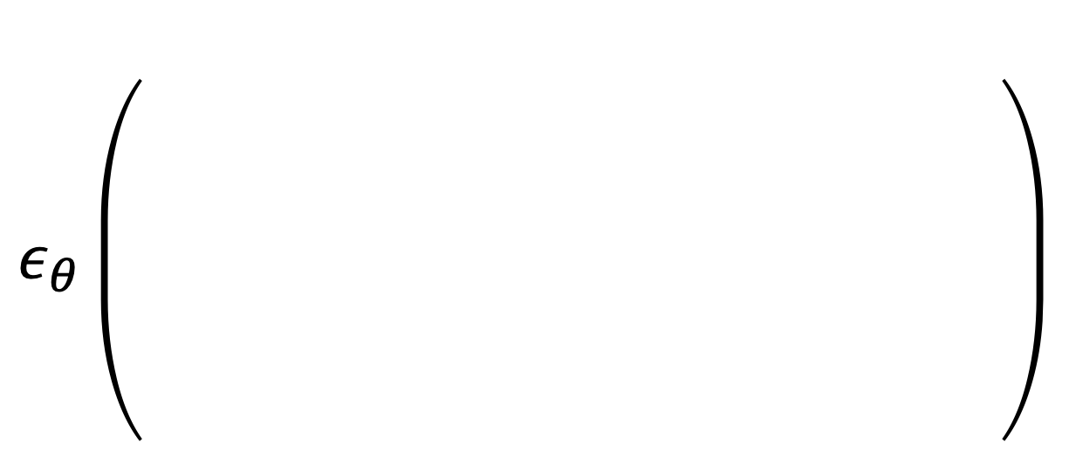

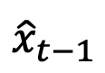
Diffusion Models: Reverse Diffusion Process
Predict noise via self-supervised learning!
A good denoiser
at each time
$$ε$$
$${\hat{x}}_{t−1}$$
$$x_{t}$$
$$ε_{θ}\left(\begin{aligned} \\ \\ \\ \\ \\ \end{aligned}\right)$$
Predict
(=denoise)
$$≈$$
X operations on image space → computationally expensive
Image Credit: https://www.youtube.com/watch?v=J87hffSMB60&ab_channel=AICoffeeBreakwithLetitia

Slide 13
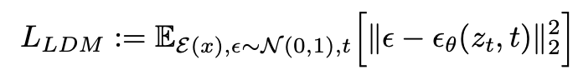
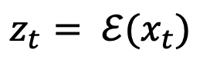
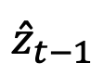
“Latent” Diffusion Models
Predict noise in latent space
A good denoiser
$$ε$$
$${\hat{z}}_{t−1}$$
$$z_{t}= ℰ(x_{t})$$
$$ε_{θ}\left(\begin{aligned} \\ \\ \\ \\ \\ \end{aligned}\right)$$
Predict
(=denoise)
$$≈$$
Latent variable
Latent variable

Slide 14
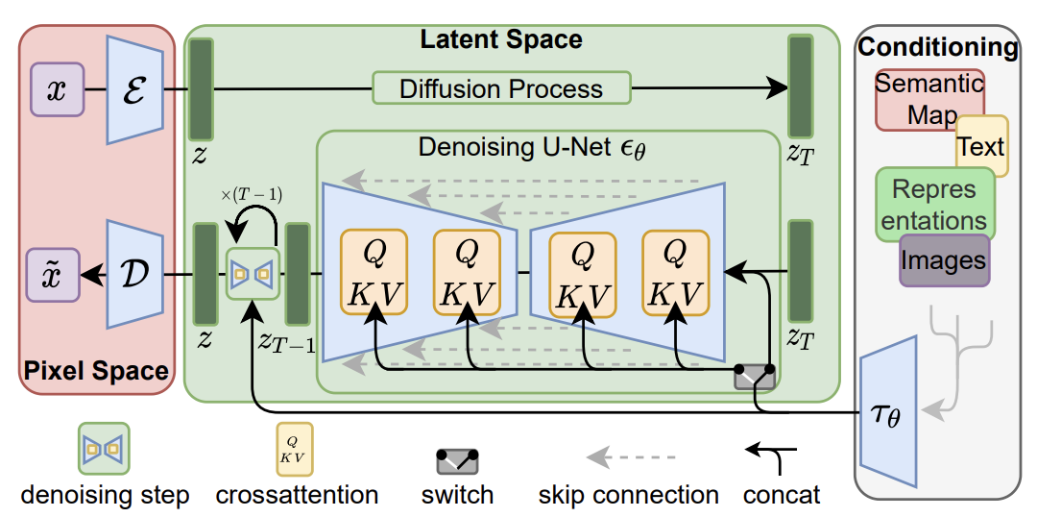
Latent Diffusion Models: Full Picture
What’s the main difference from VAE?

Slide 15
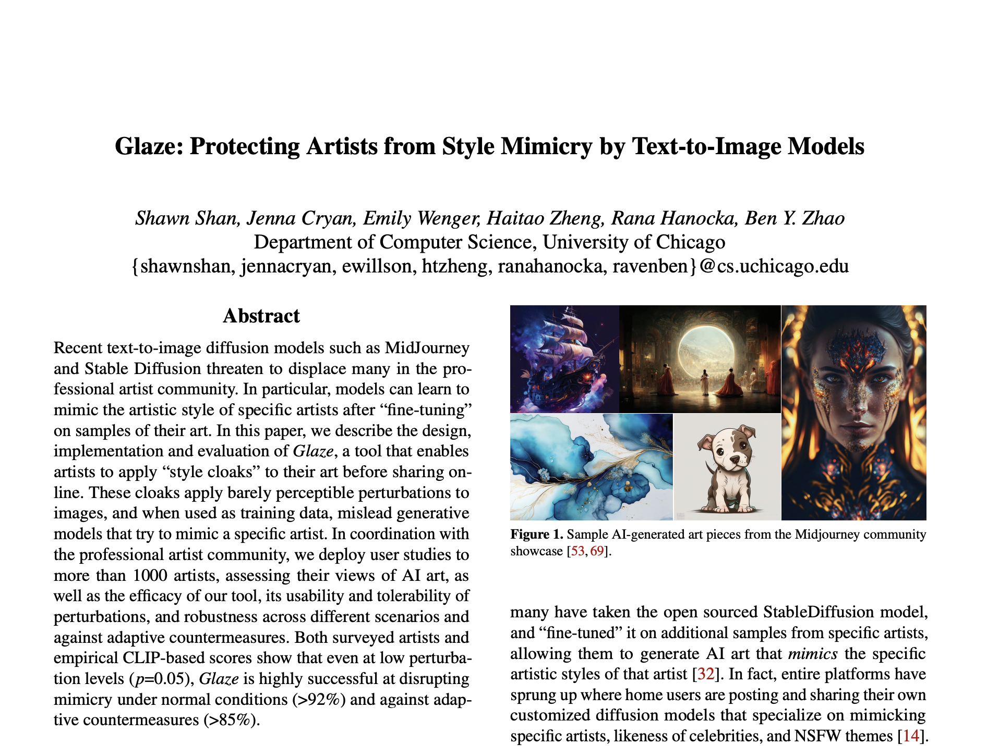
Glaze: Protecting Artists from Style Mimicry by Text-to-Image Models (Security 23)

Slide 16
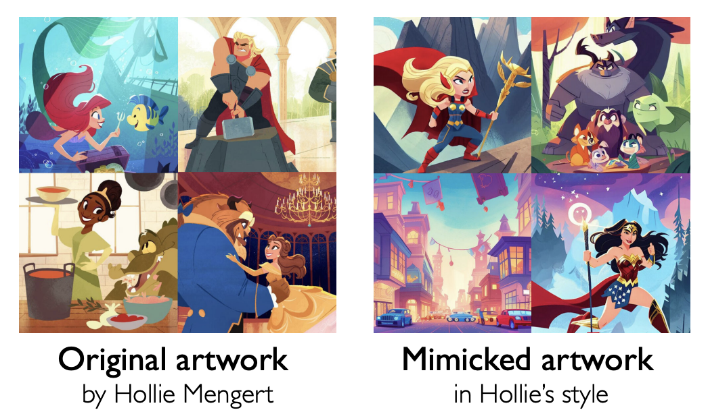
Real-work Mimicry Incidents

Slide 17
Threat Model
Artist
Mimics
Share and promote their artwork online.
Don’t want to allow replicate their art style.
Access to a public feature extractor
Copy the victim’s style
Access to victim’s art pieces
Access to a text-to-image model

Slide 18
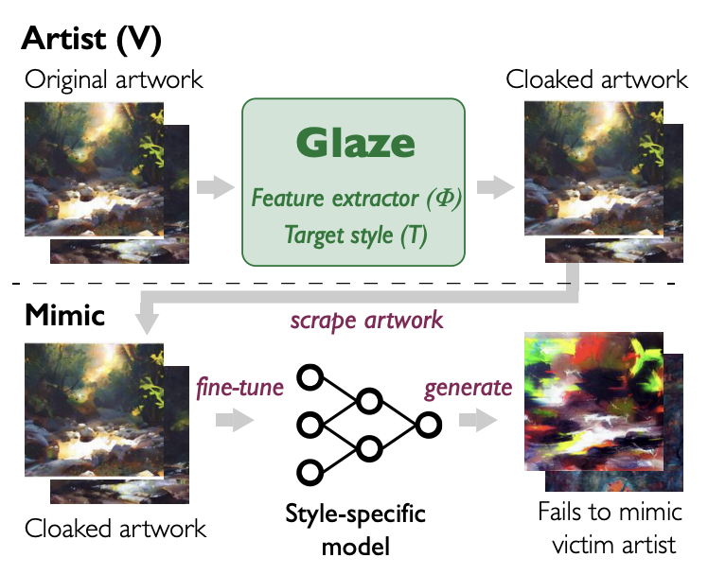
Glaze: Overview
Can you guess the implmentation of Glaze?
1. Create artwork
2. Add imperceptible perturbations
3. Release artwork
4. Collect artwork
for copying the style
6. Fails to mimic the target style.
5. fine-tune a public text-to-image model to learn the target style

Slide 19
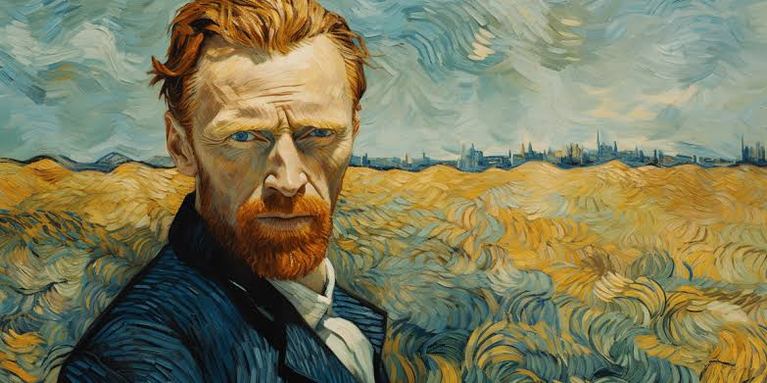
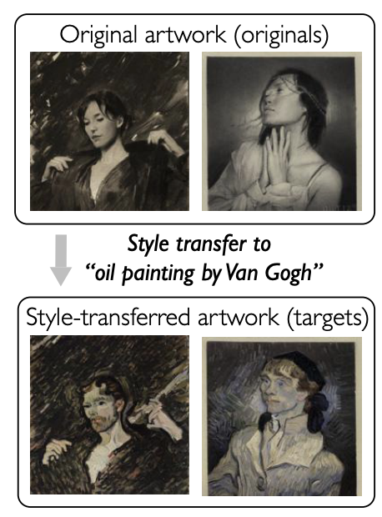
Glaze: Requirements
2. Target style
1. Encoder
3. Style-transfer

Slide 20
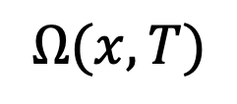
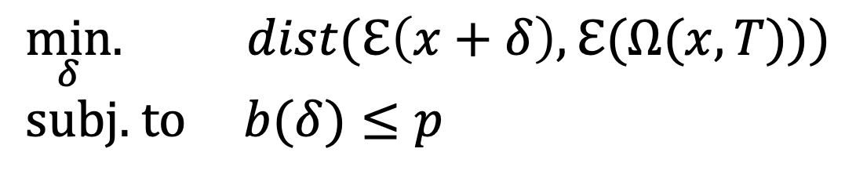
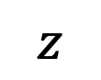
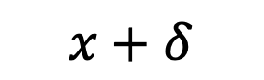
Glaze: Find Small Perturbations
$$\min_{δ}{. dist(ℇ\left(x+δ\right),ℇ(Ω(x, T)))} \\ \text{subj}\text{. }\text{to} b(δ)≤p$$
$$Ω(x, T)$$
My work with a “Van Gogh” style
$$z$$
$$x+δ$$
A Cloaked image

Slide 21
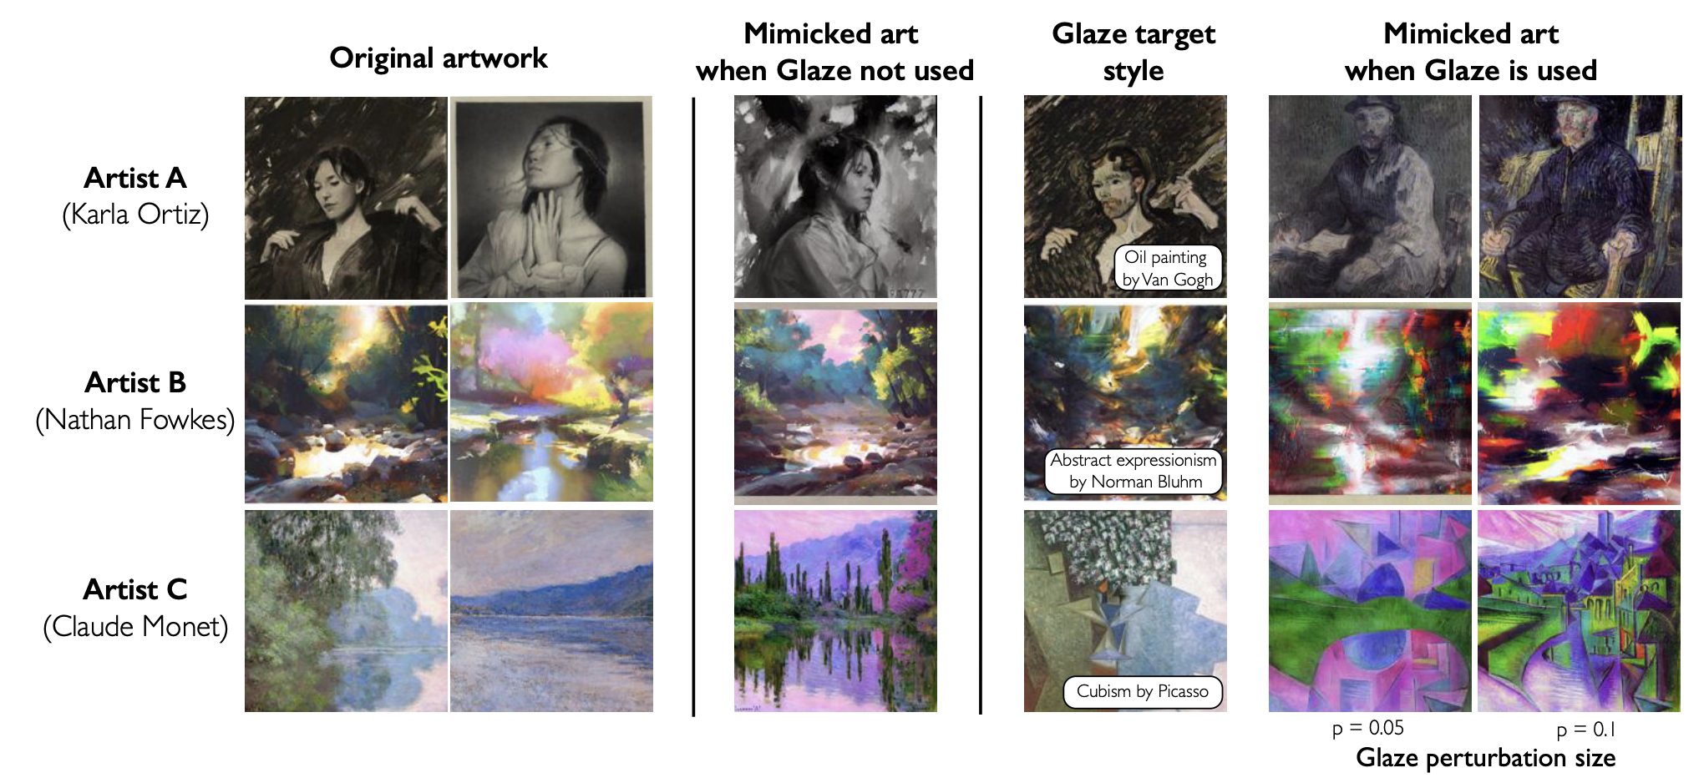
Results

Slide 22
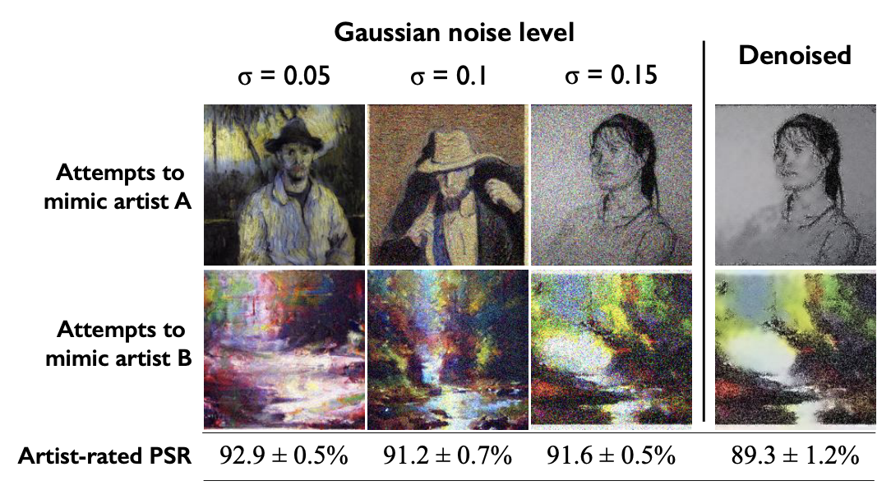
Let’s Bypass Glaze: Add Guassian Noise
Glaze still works!

Slide 23
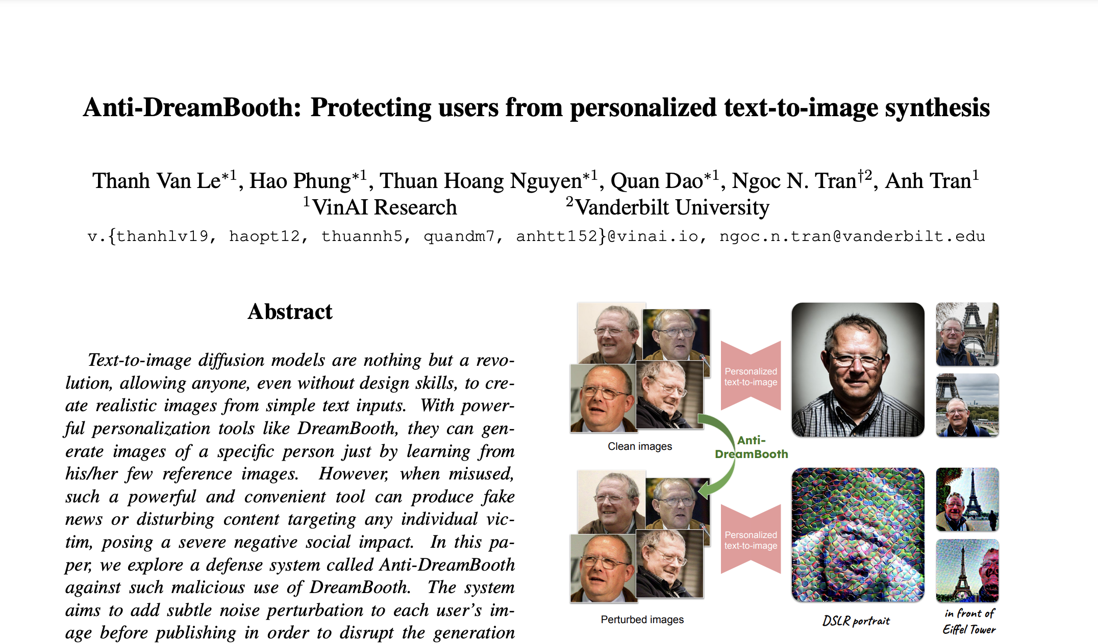
Anti-DreamBooth: Protecting users from personalized text-to-image synthesis (ICCV23)

Slide 24
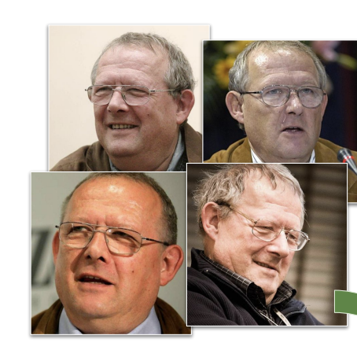
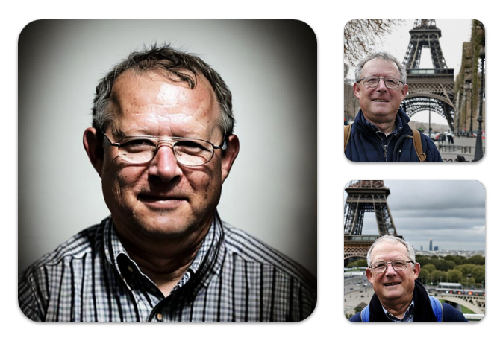
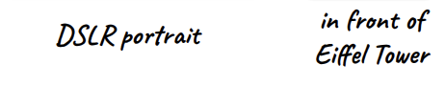
Motivation: Deepfake (≅DreamBooth)
Original Images
Fake Images
DreamBooth

Slide 25
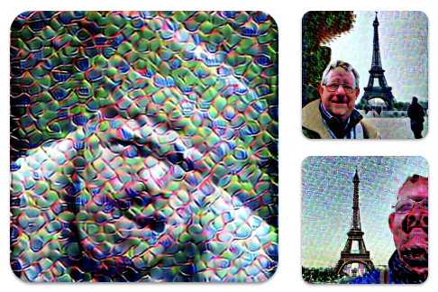
Goal: Anti-DreamBooth
Original Images
Fake-failed Images

Slide 26
DreamBooth (CVPR23)
Reconstruction Loss
$$ℒ_{DB}\left(θ\right)=𝔼_{x_{0}, ε, ε^{′},t, t^{′}}\left\{{\left\|ε−ε_{θ}(x_{t}, t,c)\right\|}_{2}^{2}+λ{\left\|ε^{′}−ε_{θ}({x^{′}}_{t}, t′,c_{p})\right\|}_{2}^{2} \right\}$$

Slide 27
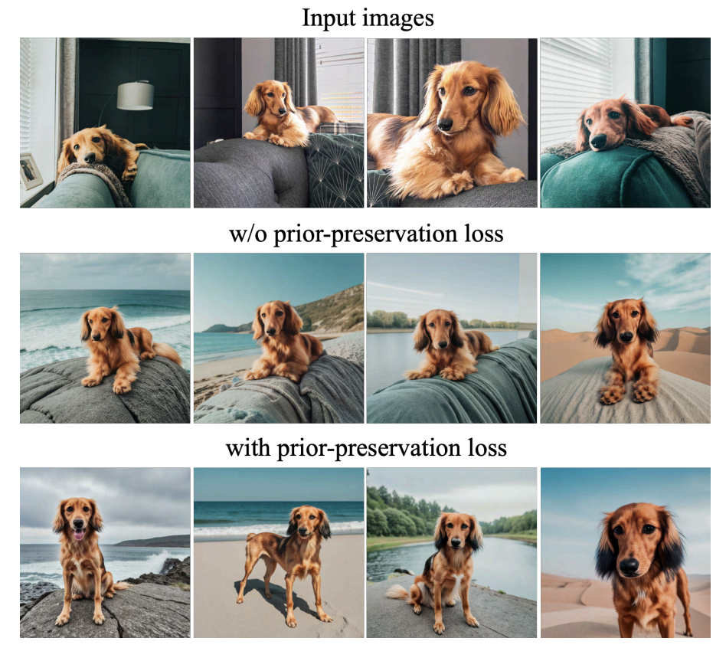
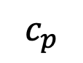
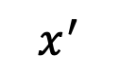
DreamBooth (CVPR23)
Prior-preserving Loss
$$ℒ_{DB}\left(θ\right)=𝔼_{x_{0}, ε, ε^{′},t, t^{′}}\left\{{\left\|ε−ε_{θ}(x_{t}, t,c)\right\|}_{2}^{2}+λ{\left\|ε^{′}−ε_{θ}({x^{′}}_{t}, t′,c_{p})\right\|}_{2}^{2} \right\}$$
Generator
(original)
$$c_{p}$$
$$x^{′}$$
A [noun]

Slide 28
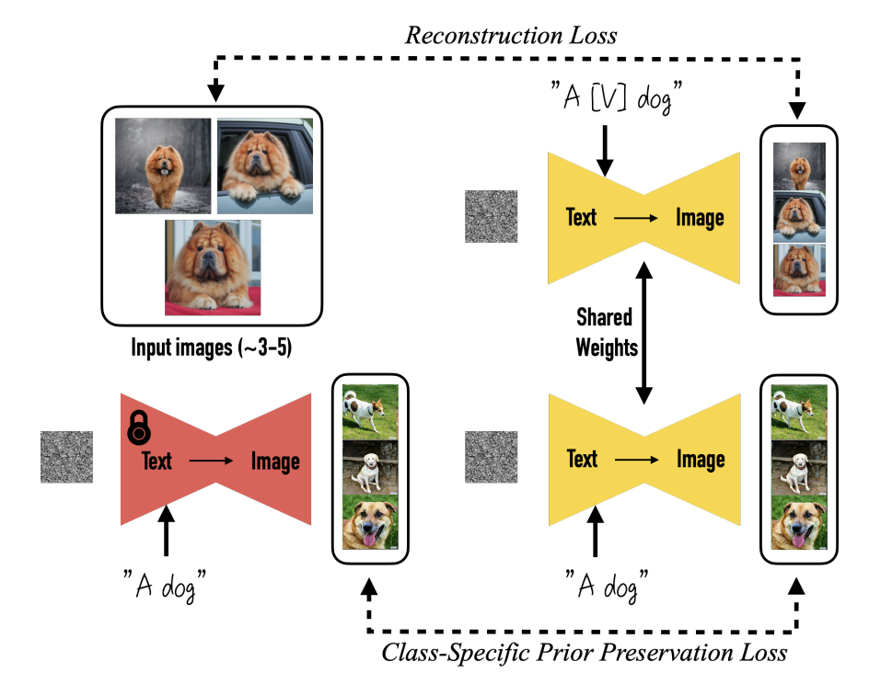
DreamBooth (CVPR23)
$$ℒ_{DB}\left(θ\right)=𝔼_{x_{0}, ε, ε^{′},t, t^{′}}\left\{{\left\|ε−ε_{θ}(x_{t}, t,c)\right\|}_{2}^{2}+λ{\left\|ε^{′}−ε_{θ}({x^{′}}_{t}, t′,c_{p})\right\|}_{2}^{2} \right\}$$

Slide 29
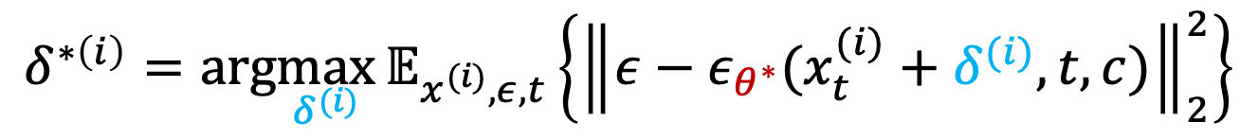
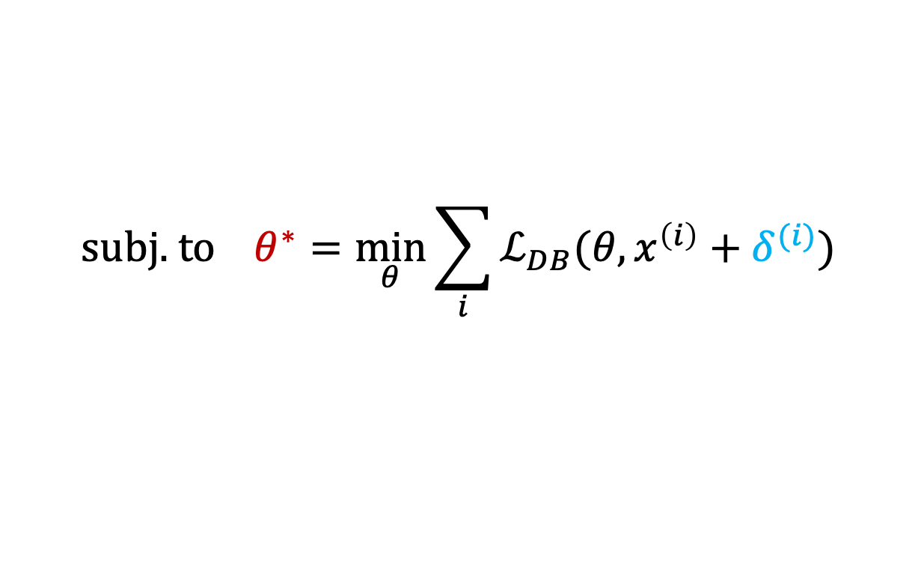
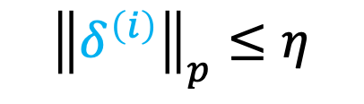
Anti-DreamBooth
Reconstruction Loss
$$δ^{∗\left(i\right)}=\text{arg}\max_{δ^{(i)}}{𝔼_{x^{(i)}, ε,t}\left\{{\left\|ε−ε_{θ^{∗}}(x_{t}^{(i)}+δ^{(i)}, t,c)\right\|}_{2}^{2}\right\}}$$
$$\text{subj}\text{. }\text{to} θ^{∗}=\min_{θ}{\sum_{i}{ℒ_{DB}(θ, x^{\left(i\right)}+δ^{(i)})}}$$
$${\left\|δ^{\left(i\right)}\right\|}_{p}≤η$$

Slide 30

Results
See the paper for targeted attaks.

Slide 31
Discussion
Glaze v.s. Anti-DreamBooth

